Slide 1
Product Roadmaps
YDMC Focus day – Strategy 2019

Slide 2

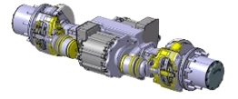
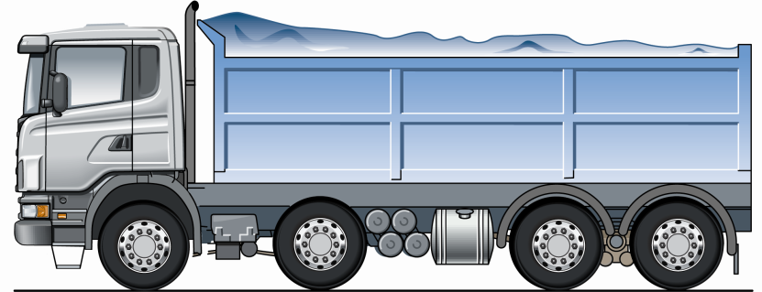


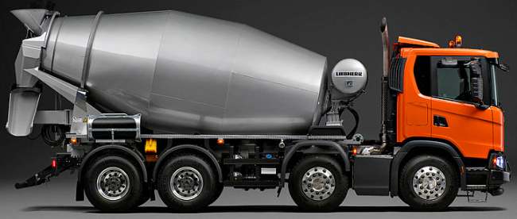



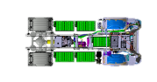
Product Roadmap
2018
2019
2020
2021
2022
2023
2024
2025
2026
2027
>
NBA
Engine
Diesel
D9U Eu6
D16U Eu6
D13 (CBE1) Eu6
D11 (DW5) Eu6
D7U (CBE3)
D16U Eu7
D13U Eu6
D13 (CBE1) Eu7
FAME
D9U Eu6
D11 (DW5) Eu6
D11 (DW5) Eu7
D7U (CBE3) Eu6
D13U Eu6
D7 Eu6
D13 (CBE1) Eu6
D13 (CBE1) Eu7
D16U Eu7
Ethanol/ED95
D16 Eu6
D11 (DW5) Eu7
D11 (DW5) Eu6
D13 Eu6
D9U Eu6
D7U (CBE3) Eu6
D13 (CBE1) Eu7
D13 (CBE1) Eu6
D7U (CBE3)
Gearbox Rear Axle
GAS
D9 Eu6
D7 Eu6
D11 (DW5) Eu6
D11 (DW5) Eu7
D13 (CBE1) Eu6/7
D7U (CBE3)
D13 Eu6
Gearbox
GW1 (G33CM) (3300Nm 12+2)
GW2 (G25CM) (2500Nm 12+2)
GW3 G38CH (3800Nm 12+2)
G25M (2500Nm 12)
G33M (3300Nm 12)
Rear Axle
RB 885
CAM1–RX1 (Medium)
CAM1–RX2 (Heavy)
CAM1–RBX1 (Medium Bogie)
CAM1–RX0 (Light)
CAM1–RBX0 (Light Bogie)
CAM1-RBX2 (Heavy Bogie)
Gearbox
P160
“EG” PTO P160
GEM 6 speed + PTO
GEM 11 speed
GEM Heavy Haulage
AGW <15t
Rear Axle
E-Axle Light/Medium
E-Axle Heavy
Hubreduction 2+N
E-FrontAxle Crawler
E-Mobility
Vehicle Type
Capacity
3xYES 330kWh
5xYES 550kWh
6xYES 660kWh
900kWh
1350kWh
Axles
City Bus, Large City 4x2 , 6x2/2
Garbage, Urban Distribution, Tipper Truck 4x2
Bus, Garbage, Urban/Regional Dist, 4x2, 6x2,8x2
Long Haul, Forestry 4x2, 6x2, 6x4
Garbage, Urban/Reg dist. 4x2,6x2,8x2
Concrete Mixer 8x4
Tipper Truck 6x4, 8x4
Coach 4x2, 6x2
Brazil bus 8x2
Coach 4x2, 6x2
E-8x6
GTW
BEV/PHEV 19.5-26t
BEV/PHEV/HEV 18t
BEV/PHEV/HEV 19.5t, 26t, 33t
BEV,PHEV,HEV <60t
BEV,PHEV,HEV 18, 26 t , 33t
BEV/PHEV/HEV 33t
BEV/PHEV 19.5 - 26t
BEV/PHEV 33t
BEV/PHEV 19.5 - 26t
BEV <60t
BEV <100t
Range
10km
40km
DBNS 17-75km DBNT 300 Km
DBNS 100-150km
DBNS 17-300km DBNT 250-300km
DBNS 300km
DBNS 200-260km, 75 km, 300 km
DBNS 300-400km
DBNS 150km
DBNS 25-30km
DBNS 400km
Charge Power
22kW AC
OPP Charge
160kW DC
CCD
CCR
Charger 2x350kW
Range Extender for EV 100-150kW
Mega Charger
Intro
^{NBA RS} ^{BEV VIP}
^{NCG} ^{PHEV}
^{MULTI} ^{BATTERY}
^{NBA RS} ^{BEV}
^{NCG PHEV Uppd.}
^{BEV} ^{TRUCKS}
^{NBA RS} ^{BEV Intro 2}
^{xEV 1.0} ^{PHEV}
^{xEV 2.0} ^{200 kW E-Machine}
^{xEV 2.5} ^{400 kW E-Machine}
^{BEV 3.0}
Legal
Consumption
ChinaPhase 3
China Phase 4
"Diesel free cities"
Paris, Athens, New Mexico, Madrid. PC and Truck?
2030 - CO2 Reduction 30%
Emission
CO2 Baseline
EPA 2021 GHG Phase 2 Nox-268 mg/kWh (FTP) be 191 g/kWh
China6
EPA 2024 GHG Phase 2 Nox-150/200 mg/kWh (FTP) be 186 g/kWh
CO2 Reduction 15%
China7?
EPA 2027 GHG Phase 2 Nox 27? mg/kWh (FTP) be 184 g/kWh
2030 - World Wide Harmonization of GHG Legislation?
EU6 Brazil?
EU7
Noise
Noise Phase 2
- N3 79/81dBA - M3 77/78 dBA
"Silent cities", demands for ultra low noise emissions
Noise Phase 3
- N3 77/79 dBA - M3 76/77 dBA
Various
Increased payloads @ specific corridors within EU

